Slide 1
¹²⁵I Iodine sales forecast

Slide 2
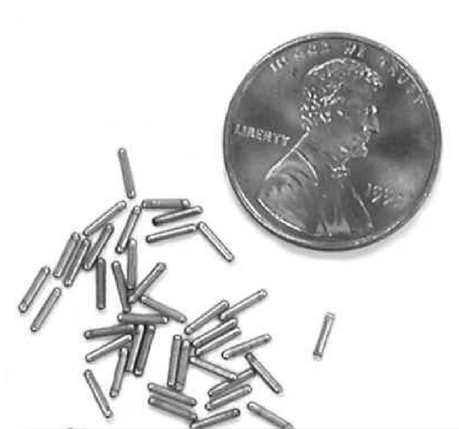
I-125: radioisotope for cancer therapy

Slide 3
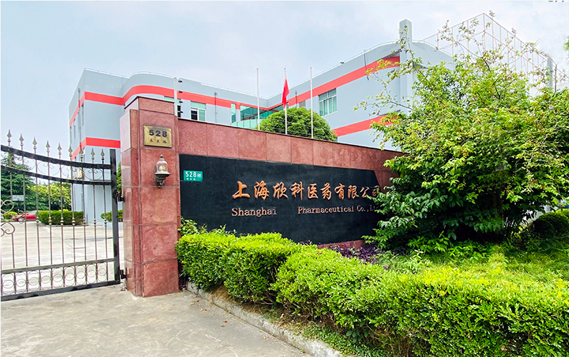
China market: fast growth, no transparency

Slide 4
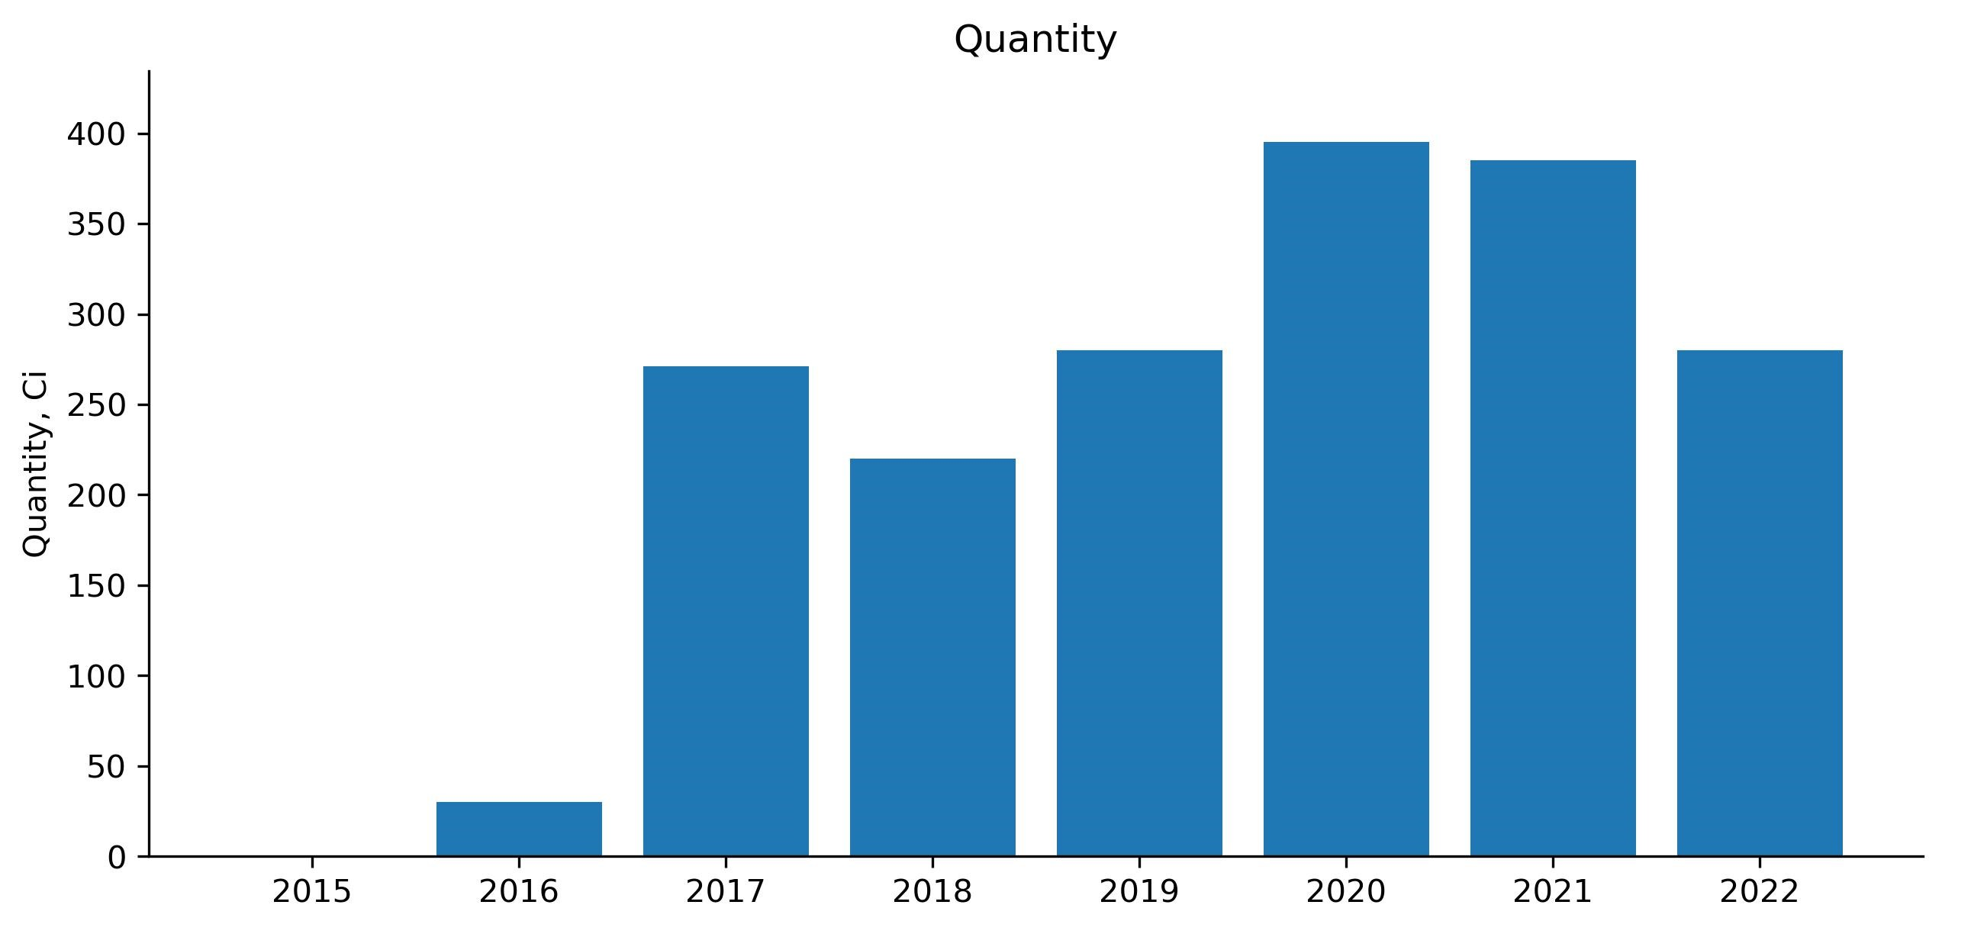
One client example: sales trends

Slide 5
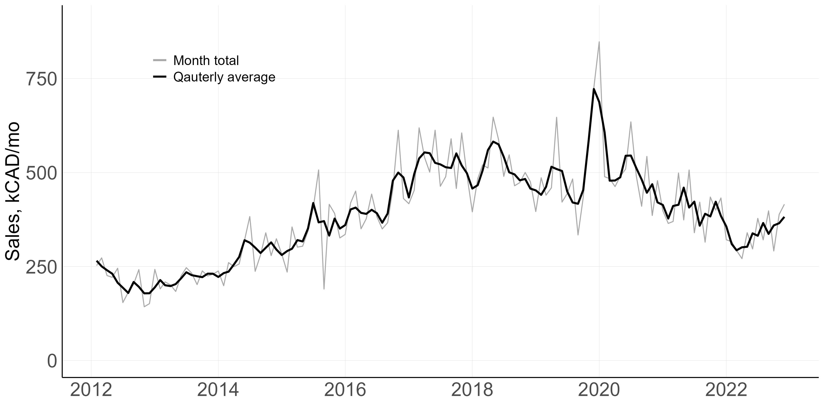
Training data: sales for the past 10 years

Slide 6
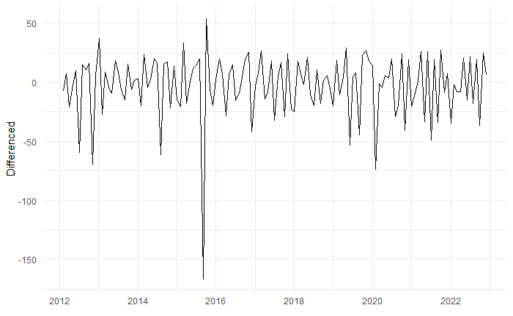
ARIMA model selection: detrending by differencing

Slide 7
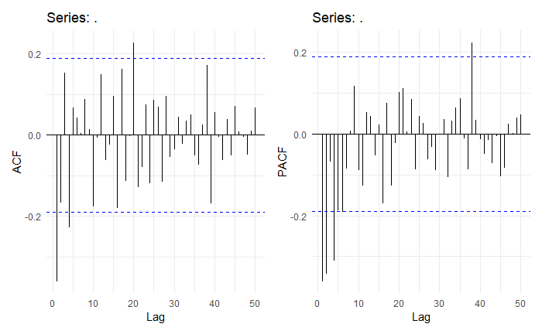
ARIMA model selection: ACF and PACF

Slide 8
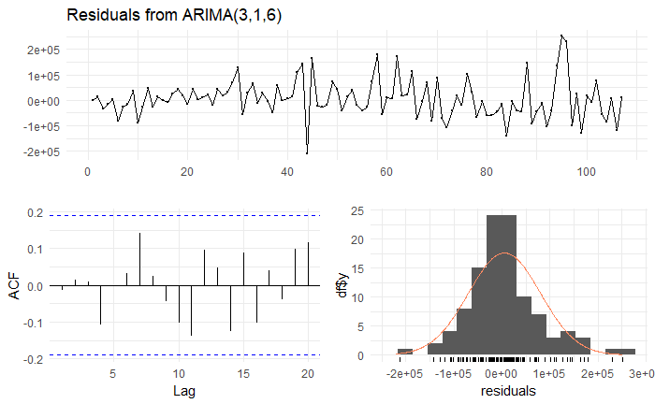
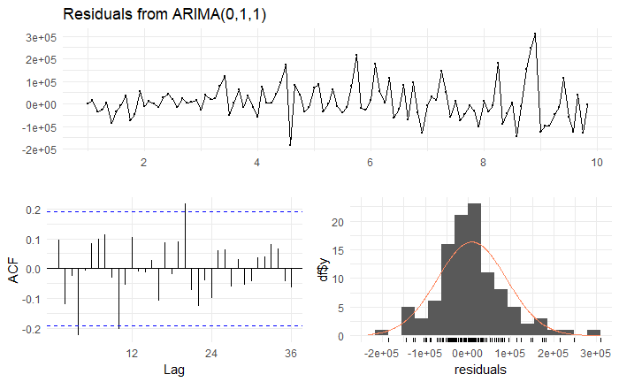
ARIMA model selection: models

Slide 9
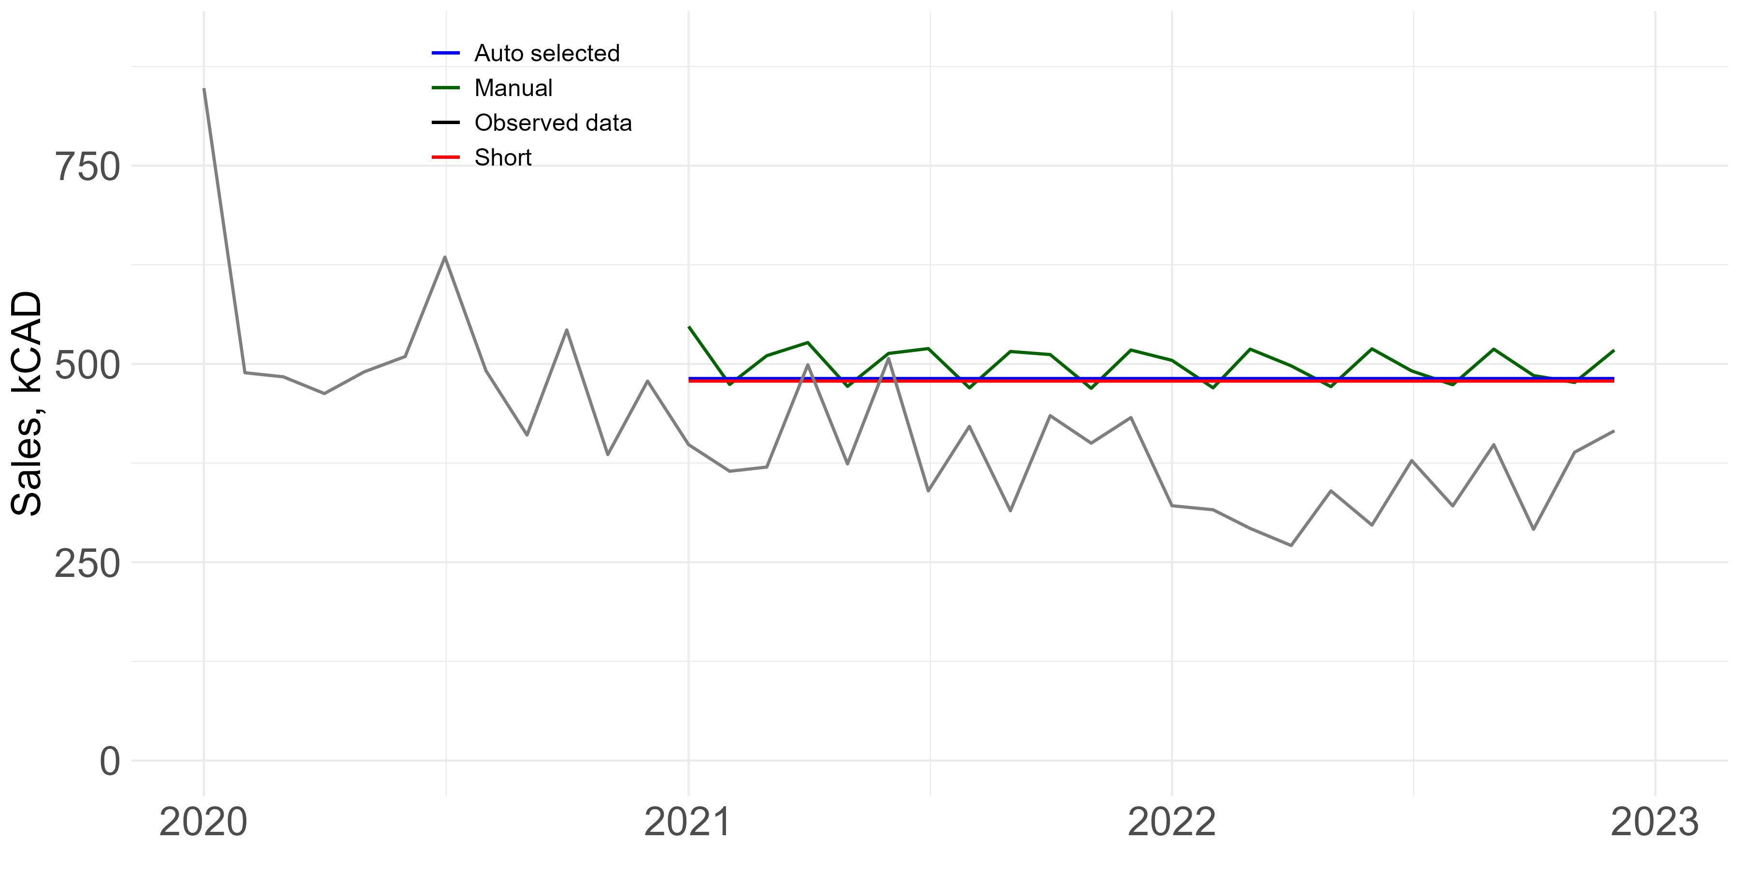
ARIMA: approach that does not work

